Slide 1


Slide 2
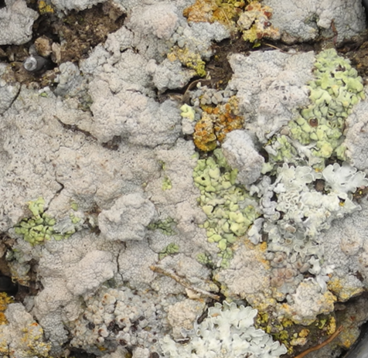

Slide 3
how to efficiently feed data into R and further manipulate it to have it ready for statistical analysis and plotting
work with R data frames
data visualization...
stronger foundation for data cleaning + analysis and new ways to visualize my data in R.
using R to analyse large datasets
More efficient way to analyze data as I'm only using Excel and SPSS.
Help for the analysis for the thesis
how to import data from Matlab to R.

Slide 4
Associations between behaviour and gut microbiota in laying hens
How did past amber forests look like in Asia?
Cell assay development and urinary excretion studies
Biodegradable polymers
Nitrogen inefficiencies, nitrate leaching caused by different organic and mineral fertilization systems.
Does the reuse of pineapple residue through soil incorporation in pineapple cultivation effective to improve nutrient cycling and C sequestration in the soil?
What effect has air pollution on skin?
Emotional processing in the brain
Chicken immunology
How does the hepatic thyroid hormone status change on modulating hepatic deiodinase enzyme?
Influence of various pharmaceuticals on human UDP-glucuronosyltransferase activity
Dissect epidermal cell development in Arabidopsis via single-cell technology
What influence do shocks and crisis situations have on individual food behavior?

Slide 5
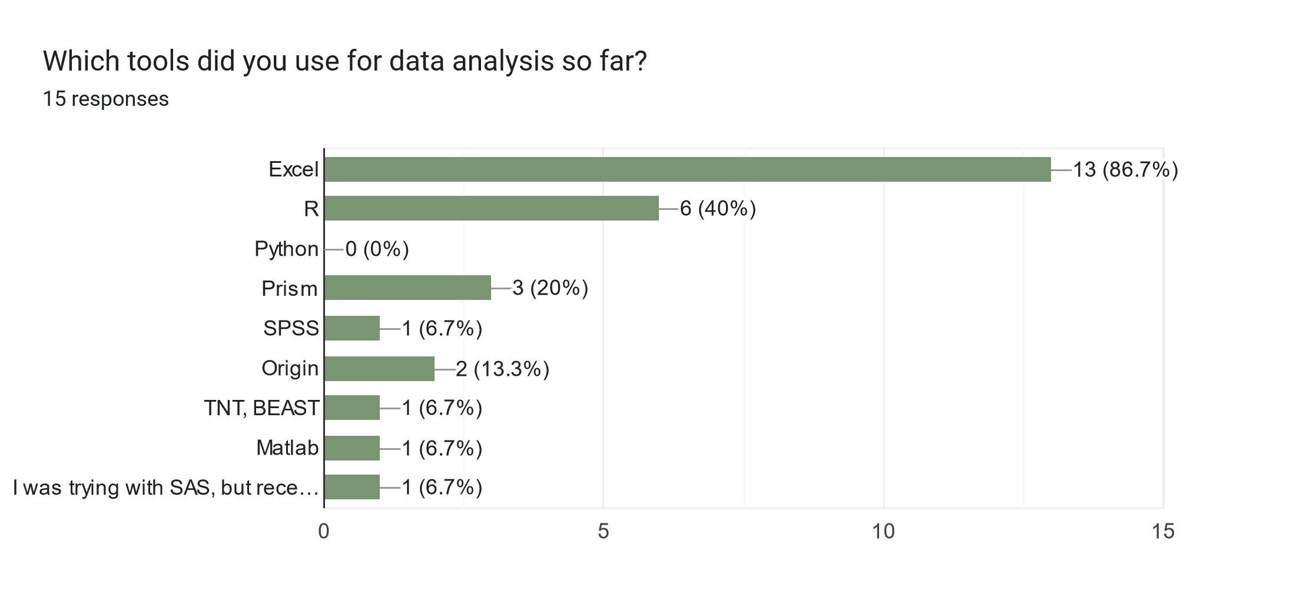

Slide 6
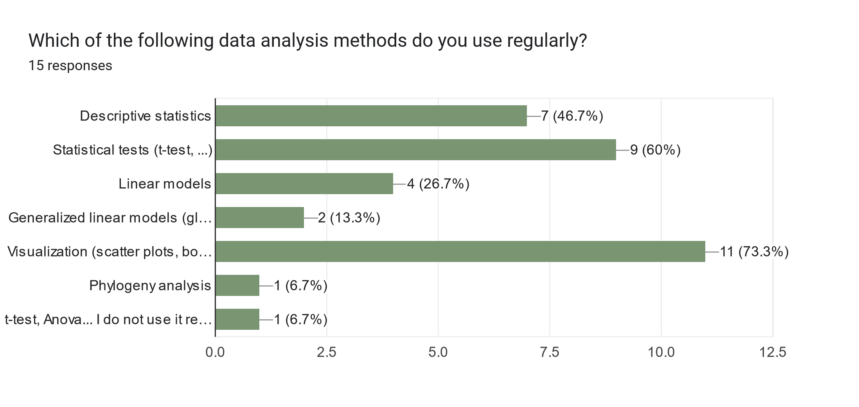

Slide 7
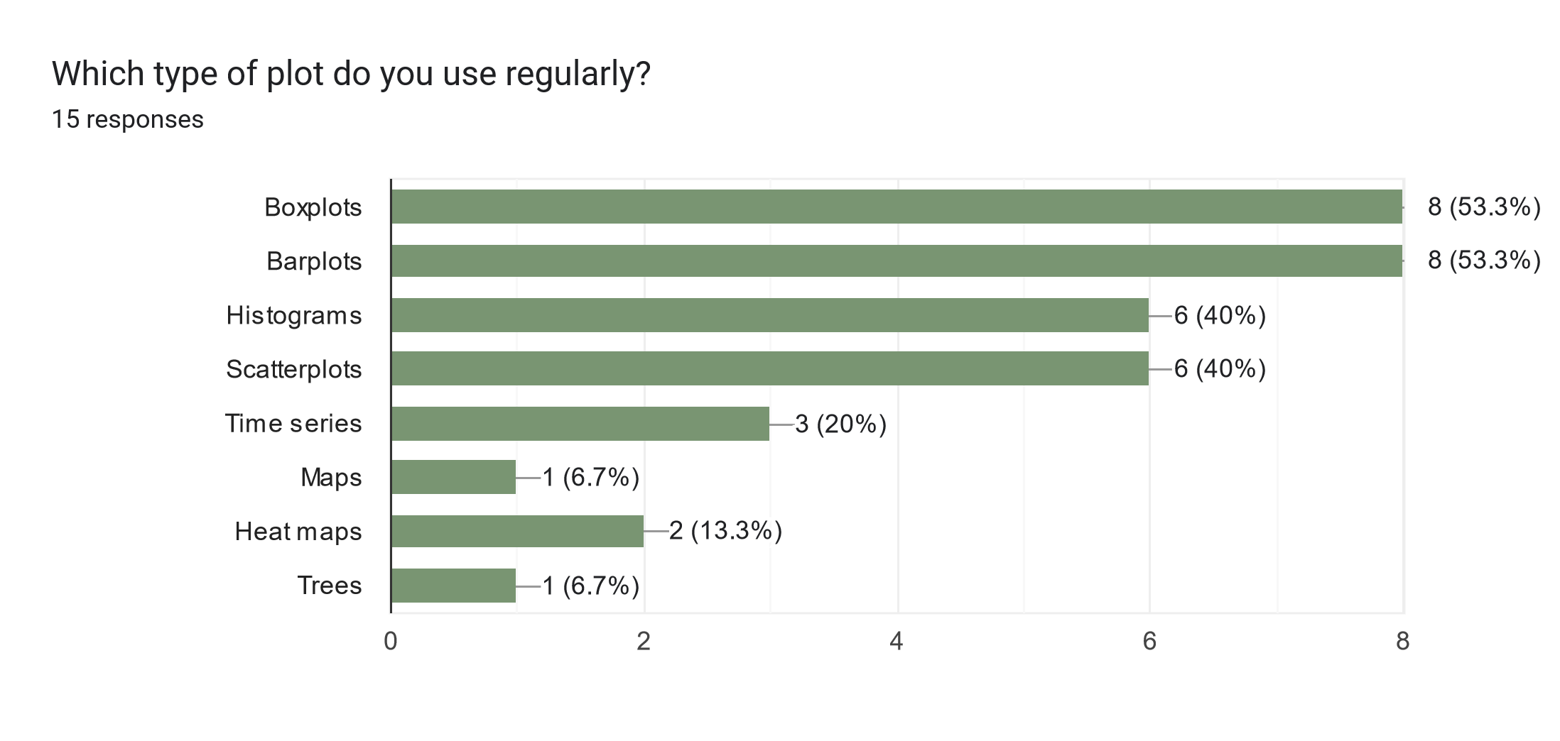

Slide 8
Visualize
R basics
Import
Tidy
Transform
Communicate
Stats
Data analysis workflow

Slide 9
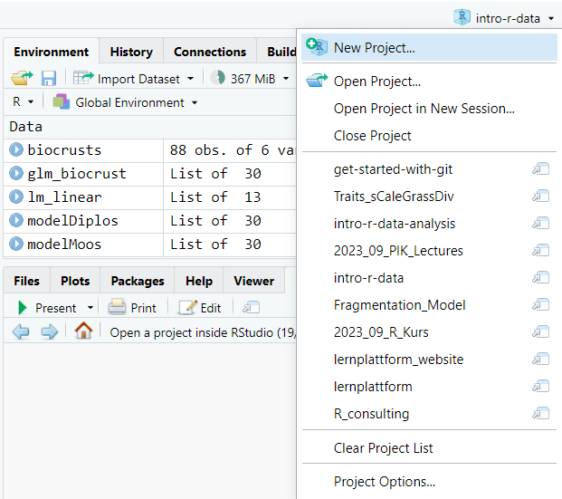

Slide 10
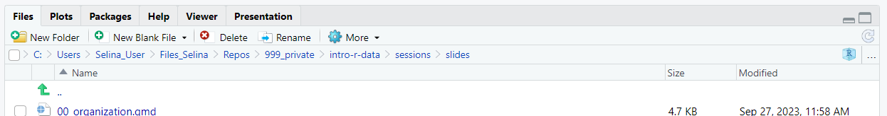
Project path
Go to project root
Open project in file explorer
Navigate one level up

Slide 11
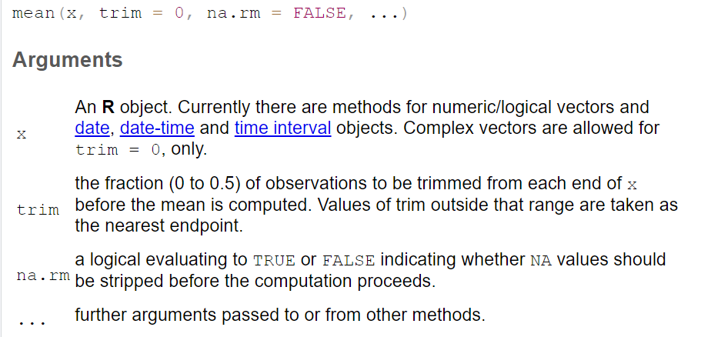

Slide 12
Function name
Input
Processing
Output
Side effects

Slide 13
mean
c(1, 5, 6)
Add values and divide by the length of the vector
4

Slide 14
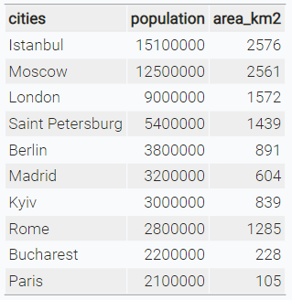
character
numeric

Slide 15





Visualize
R basics
Import
Tidy
Transform
Communicate
Model
Data analysis workflow

Slide 16

Data structure
Import
Tidy
Transform
Visualise

Slide 17
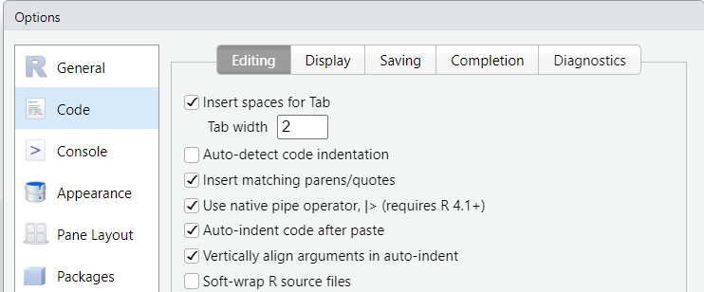

Slide 18
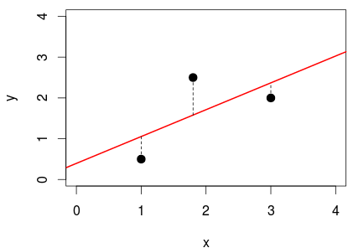

Slide 19
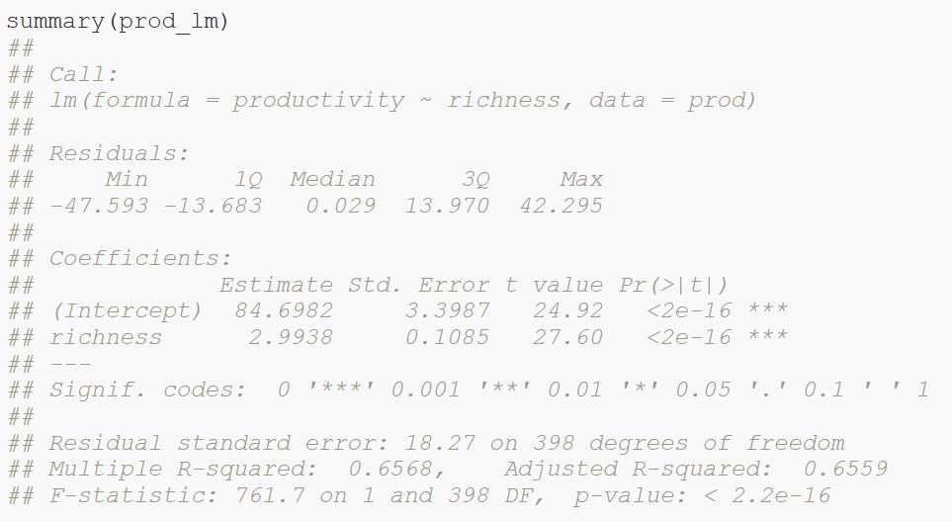
Calculated model
Distribution of residuals (errors)

Slide 20
Model coefficients:
Intercept = 84.7
Slope = 3
Standard error of coefficients

Slide 21
t-statistics: ratio of coefficients to their standard error

Slide 22
Coefficient of determination R²

Slide 23
F statistics: ratio of explained variance compared to null model

Slide 24
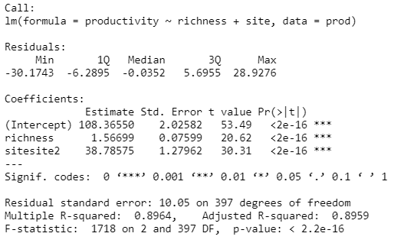
Intercept site1 = 108.4
Slope = 1.6
Intercept site2 = 108.4 + 38.8

Slide 25
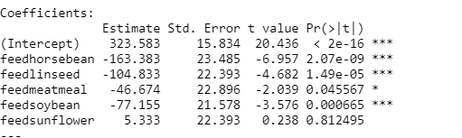
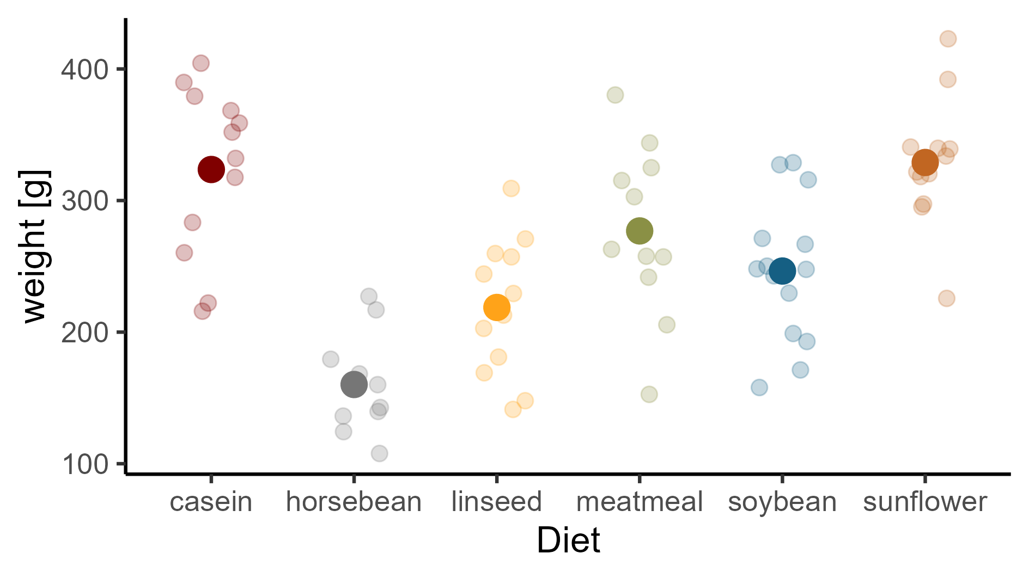

Slide 26
(Intercept) + feedlinseed
(Intercept) + feedsoybean
(Intercept)
(Intercept) + feedsunflower
(Intercept) + feedhorsebean
(Intercept) + feedmeatmeal

Slide 27
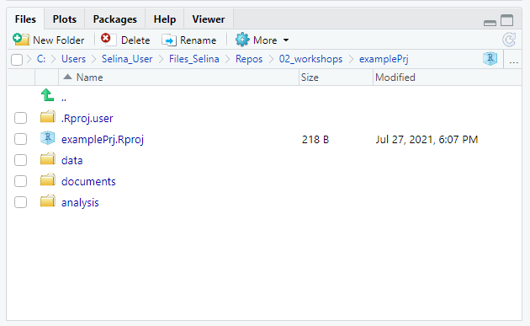
Navigate to project root
Project path
Navigate one level up
Open project in file explorer

Slide 28
Visualize
Import
Tidy
Transform
Communicate
Model
Understand

Slide 29
y
No interaction
y
Interaction
x₁
X₂
a
b
x₁

Slide 30




Slide 31
normal
distribution?
Kolmogorov-Smirnov-test, QQ-test, Shapiro-Wilk-test,..
yes
equal
variance?
F-test
no
yes
no
equal
mean?
t-test
Welch-
test
Wilcoxon-rank- sum-test
Note:
Levine-test not necessary, if you are interested
in equal means, but not equal variances!

Slide 32
Truth
H0 is true
H0 is false
Correct decision
Probability: 1 - α
Type II error
Probability: β
Accept H0
Decision based on statistical test
Type I error
Probability: α
Correct decision
Probability: 1 – β
(Power)
Reject H0

Slide 33


Scientific idea
working hypothesis H1
and
null hypothesis H0
p: how likely would it be to observe the data if the null hypothesis was true?
unlikely (p ≤ α):
reject H0
otherwise: not not reject H0
collect data
chose level of
significance α,
test the null
hypothesis
errors possible

Slide 34
A
B
joined and sorted

Slide 35
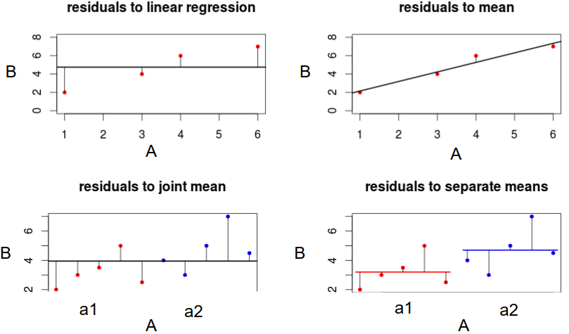
Residuals to mean
Residuals to regression line
Residuals to joint mean
Residuals to separate means

